Slide 2



FILE MANAGEMENT in OS

Slide 3

Contents
 File
 File
 File
Concepts
Types
Operations
 Access Methods
 Directory Structure
 File System Structure

Slide 4

File Concept
 The
file
is
a
collection
is recorded
of
related
information that
device.
 The files stores
on storage
information
and data.
 It
is
a
way
of
data
collection
which
is
used as medium of
giving input
and collecting output from
any application.

Slide 5

File Types
1.
–
–
–
–
2.
–
Ordinary Files ( Regular Files )
It
It
It
contains user information
contains text or executable programs is either text file or binary file
User can apply various operations
Directory Files
It is like a folder that contains files or
other folder
It don’t contain data
But they have references to file contain within them
–
–

Slide 6
File Types
3. Device File
–
–
It contains device information
It is used to communicate with hardware
Device file is of two types
Character special file
–
i.
It is a hardware file which read
data character by character
e.g.: mouse, printer
Block file
It contains data related to hard
or
write
ii.
disk

Slide 7
File Types
4.
–
FIFO Files
It is a file which
provides temporary
buffer for two or more process to
communicates by writing data &
reading data from buffer
The buffer associated with this file is allocated when any process opens the file & buffer is discarded when all processes which are connected to this file close their reference
–

Slide 8

File Operations
1.
2.
3.
4.
5.
6.
7.
8.
9.
10.
11.
Create
Delete
Open
Close
Read
Write
Append
Seek
Get Attributes
Set Attributes
Rename

Slide 9

Directory
Structure
• To keep track of files, file systems normally
have directories of folders.
• Directories are system files for maintaining the structure of the file system.
1. Single Level Directory Structure
2. Hierarchical Directory
i.
ii.
iii.
Two Level Directory Structure
Tree Level Directory Structure
Acyclic Graph Directory

Slide 10

Single
Level
Directory
Directory
File 1
File 2
File 3
Figure : Single Level Directory

Slide 11

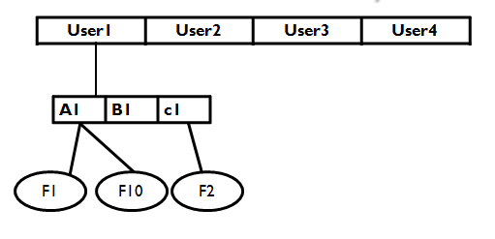
Hierarchical
Directory
User1 User2 User3 User4
A1 B1 c1
F1 F10 F2
Figure : Two Level Directory

Slide 12
Hierarchical
Directory
Root
Sort.c
b.txt
a.txt
reverse.cp
p
Figure : Tree Level Directory

Slide 13
Hierarchical
Directory
b.txt
b.txt
b.txt
Figure :
Acyclic
Directory

Slide 14

File System
Structure
 The concept of file system is to access
the disk efficiently. It allows data to
store & retrieve from disk.
 File system structure is composed
many layers as following:
1. Input-Output Control Interface
of
✓
It consist of device driver and interrupt
handler.
Both are used for data transfer between
memory & disk
The device driver translates file level command & output is hardware instruction
✓
✓

Slide 15
2. Basic File System Layers
✓
✓
It generates commands for device driver
Device driver read or write physical block on
disk
File Organization Module Layer
This layer translates logical block address to physical block address
Logical System Layer
It manages metadata of any file like location &
permission of file
Application Program Layer
This is a layer in which user creates an application program
3.
✓
4.
✓
5.
✓

Slide 16

Access Methods
 The
information
stored
in
the
read
file
into
needs
to
be accessed
and
the computer memory.
 There
are
different
methods
available
to do it.
1) Sequential Access
2) Indexed Access
3) Direct Access

Slide 17

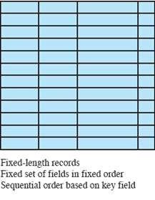
Sequential Access
▪
Most
common
form
of
file
structure
▪
A
fixed format
is
used
for
records
Key field uniquely identifies
▪
the
record
order
&
determines
storage
▪
Typically
applications
used
in
batch
▪
Only organization that
stored on tape as well
is easily
as disk

Slide 18

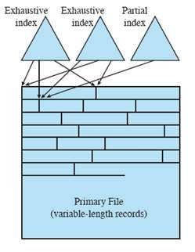
Indexed Access
▪
Records
are
accessed
only
through their indexes
Variable-length records can be employed
Exhaustive index contains one entry for every record in the main file
Partial index contains entries to records where the field of interest exists
▪
▪
▪
▪
Used mostly
in
applications
where
information
Examples reservation
timeliness
is critical
of
▪
would
be
airline
and
systems
inventory control systems

Slide 19

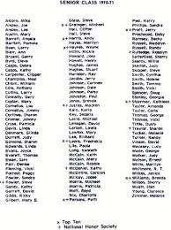


Direct Access
▪ Access directly any block of a known address
▪ Makes use of hashing on the key value
▪ Often used where:
◦
◦
◦
very rapid access is required
fixed-length records are used
records are always accessed one at a time

Slide 20

References
 Operating System By Andrew
Tanenbaums

Slide 21
THANK
YOU

